Slide 1

What do we know about students and mathematics in transition?
Investigators:
Julian Williams (PI), Laura Black, Pauline Davis, Birgit Pepin and Geoff Wake
Research Associates: Valerie Farnsworth, Paul Hernandez-Martinez, Maria Pampaka
Associate Research Fellow: Diane Harris
Associate Research Students: Kamila Jooganah and Irene Kleanthous
Research Statistician: Graeme Hutcheson
Administrator: Tim Millar

Slide 2
The ‘constructs’/instruments within the surveys
Disposition to complete chosen course
Preparedness and usefulness of ways of studying
Transitional experiences
Mathematics dispositions
Perceived pedagogic practices at pre-university (maths) experience
Perceived pedagogic practices at university (maths)
Mathematics self efficacy
Confidence with mathematics
Usefulness of mathematics
Perceived mathematical support at university

Slide 3
Transition
Transitional problems can be critical and students often regard mathematics as ‘difficult’ during transitional periods.
Our analysis of students' interviews showed a more positive discourse, one of reported challenge, growth and achievement:
transition was not seen as an obstacle
this was reflected in a need for a better understanding of the subject.
We propose to re-think transition as a question of identity.
Notes:
Previous work on transition between institutions suggests that transitional problems can be critical, and students often regard mathematics as ‘difficult’ during transitional periods.Our analysis of students' interviews showed a more positive discourse, one of reported challenge, growth and achievement:
transition was not seen as an obstacle but as an opportunity to develop a new identity.
this was reflected in a need for a better understanding of the subject, and for being more responsible for their learning.
We propose to re-think transition as a question of identity in which persons see themselves developing due to the distinct social and academic demands that the new institution poses. Conceptualising transition in this way could have important practical implications for the way that institutions support students' transition.

Slide 4
Educational Research Literature
The literature mostly refers to primary-secondary school transition
Galton, M. 2000. Special issue on school transfer and transition. International Journal of Educational Research , 33(4): 321–449.
Schagen, S. and Kerr, D. 1999. Bridging the gap? The national
curriculum and progression from primary to secondary school, Slough: NFER.
There is now a growing literature on transition to university
Gueudet, G. 2008. Investigating the secondary – tertiary
transition. Educational Studies in Mathematics , 67: 237–54.
However, the issue of transition to post-compulsory/ further education is relatively under-researched.

Slide 5
The existing research on institutional transitions in general suggests that there are three broad areas of concern:
Social dimension:
Anderson, L.W., Jacobs, J., Schramm, S. and Splittgerber, F. 2000. School transitions: Beginning of the end or a new beginning?. International Journal of Educational Research , 33(4): 325–39.
Continuity of curriculum and pedagogy:
Shagen and Kerr 1999
Individual progression:
Mann, P. 1997. LEA strategies for effective transition from KS2 to KS3 , Slough: Education Management Exchange.
Notes:
Social dimension: this involves students becoming comfortable in the new institution, finding their way round, making new friends, and so on. These so called ‘social discontinuities’ relate to the students' sense of belonging to the new institution
Anderson, L.W., Jacobs, J., Schramm, S. and Splittgerber, F. 2000. School transitions: Beginning of the end or a new beginning?. International Journal of Educational Research , 33(4): 325–39.
Continuity of curriculum and pedagogy: there is an awareness of the ‘gap’ between practices on either side of the transition, with implications for action to minimise the potentially risky consequences for learners by trying to ‘bridge the gap’
Shagen and Kerr 1999
Individual progression: the receiving institution needs to become aware of, and take account of, the individual history and progression of each learner; the exporting institution needs to provide relevant, adequate and timely information that the receiving institution can trust and use
Mann, P. 1997. LEA strategies for effective transition from KS2 to KS3 , Slough: Education Management Exchange.

Slide 6
An Opportunity?
As is evident from these concerns, transition is generally viewed in this literature as a problem rather than an opportunity.
There are only a few studies, to our knowledge, that have suggested that transitional periods can be chances for learners to develop new positive identities.
Lucey, H. and Reay, D. 2000. Identities in transition: Anxiety and excitement in the move to secondary school. Oxford Review of Education , 26(2): 191–205.

Slide 7
Findings
The GCSE course is said to be inadequate preparation for many students with pass grades (especially grade C, but increasingly also grade B) for AS level study: students' algebra is usually mentioned by these teachers as the key problem.
Many of the teachers in our projects also reported their concerns about students not being suitably prepared to be autonomous learners.
Some of our students reported very bad experiences of mathematics teaching in GCSE classes, with many different teachers, supply cover, and so on. Behaviour and discipline in GCSE classes is also often said to have been poor.
Notes:
Drawing on the case study data in our projects, we can say that our case study teachers’ perceptions of the problems of transition mirror this literature: the GCSE course is said to be inadequate preparation for many students with pass grades (especially grade C, but increasingly also grade B) for AS level study: students' algebra is usually mentioned by these teachers as the key problem.
Additionally, many of the teachers in our projects also reported their concerns about students not being suitably prepared to be autonomous learners, a problem that has been well documented and analysed in the literature
Some of our students reported very bad experiences of mathematics teaching in GCSE classes, with many different teachers, supply cover, and so on. Behaviour and discipline in GCSE classes is also often said to have been poor, and students may look forward to better behaviour, and not expect a need for discipline or control by their teachers.

Slide 8
The Social Dimension
One student mentioned that he imagined the start of college would be “quite nerve-racking, with quite a lot of new people and teachers and a completely different school”.
However, this anxiety was then balanced with a more positive attitude towards the future: “ … but I think once we get used to it it'll be quite enjoyable if there's a lot more interactive subjects and meeting new people”.
Another student shared a similar view, by acknowledging that the start of college would be “quite scary, also exciting, as there will be a lot of different people there”.
Other students expressed their feelings towards the new social setting as an ‘exciting’ personal opportunity to develop in a ‘better’ environment:
I think I'm quite excited at being … in a way as we're getting up to leaving school I was getting quite excited because of going somewhere new and you get to meet loads of different people that are coming from other different secondary schools that I've never met before.
In general, all of these students adopted the attitude of “looking forward to the new experience”.

Slide 9
Coherence of curriculum and pedagogy (in mathematics)
Our students mentioned how different they expected maths (and other subjects) to be from their previous experience. For instance one student whose older sister was taking further mathematics at the same college that she planned to go to, said:
I know it will be completely different from GCSE because one of the teachers just told us that a completely different level of any subject comes really different and it will be very hard, so I guess I know that and I'm going to expect something really hard, yeah, so …
Another student said “can't see how it can just jump up in difficulty that much, but it will get more complex and I guess more concentrated”. However, she considers herself “ready for it, I mean I'm definitely ready to leave school”.
Notes:
Some of them had a better idea of what to expect (for example, talking to teachers or older siblings or attending open days), but in general the feeling was one of a ‘step-up’ in difficulty. This ‘move up’ was accompanied by a sense of personal development, in which they were leaving the ‘easy’ things behind and coming into a ‘harder’, more ‘grown up’ learning stage.

Slide 10
Coherence of curriculum and pedagogy (in mathematics) (cont)
This sense of leaving school behind and ‘moving up’ in terms of learning new, harder material at college is shared by most of these students.
Well I know the workload is going to probably be a lot more because we've been … we were told when we went round for the induction day that the one thing … they told us is that the workload would be more, because we'll be learning things, some things we'll have done before and it'll just be adding on to what we know, but some things will be totally new, so … but I'm quite looking forward to it. I'm looking forward to something different from GCSE.
This student also mentioned the fact that she expected college to be different because “everybody at A-level has really chosen to do these A levels and everyone is going to be working, hopefully, as hard as they can, so it's a better environment to be in”.

Slide 11
Coherence of curriculum and pedagogy (in mathematics) (cont)
Another perception is that at school, they “just tell you facts, and you just have to take them as they are, they don't tell you why things are like that, so that, it's harder to understand”.
Another student agreed:
I think it's a lot better than when I was doing my GCSEs and it's easier to understand … and then I know what I am doing and understand it more … In GCSE, I don't think they explain it as much and it's more just, do questions … I think here they go through it more and you understand easier.

Slide 12
Coherence of curriculum and pedagogy (in mathematics) (cont)
Highly relevant to the perception of mathematics at the transition stage was the theme of mathematics being difficult because a lot of it was ‘new’ and maybe, more importantly, when it seemed disconnected from what they knew (completely different from GCSE). This student had done very well at GCSE, but had troubles when he started college:
My first lesson was surds... so I didn't really know what was going on, and then I just struggled with the work and it sort of scared me in the first week … ‘cos it's your first week so you're thinking “Oh, this is going to continue … and it's probably going to get worse”. Then a mate of mine who went to the same school, who got B overall and I got A, turned round to me and said “you're smarter than me, I don't see why you dropped it.”

Slide 13
Coherence of curriculum and pedagogy (in mathematics) (cont)
The ‘challenge’ – when it is achievable – is relished after the event however, as a change of identity: “I think it's harder at (college), but you can tell you are moving on”. The mixture of social and work – everything being new at once – can sound potentially overwhelming. For one student the change involved:
Loads of new people and getting used to your new classes, getting used to your new teachers, and trying to understand the work and that is really hard at the minute, but I like it and I'm getting OK with it. I have student support … which is another teacher (who) makes me understand.
This was summed up by another student, who said that GCSE to A level was a big ‘step’ but she enjoyed overcoming the challenge.

Slide 14
Individual information-progression in mathematics for AS
This issue of individual difference and progression relates principally to the students with weaker GCSE backgrounds, for whom everything seems ‘new’ and therefore hard.
From what teachers told us in interviews, this happens when the teaching assumes a ‘higher’ GCSE background and applies to algebra in particular.
We believe that there is no real problem with transition of information here: the colleges know the GCSE background of their incoming students. This is, in our opinion, a curriculum pathways problem, and concomitantly a funding problem.
Notes:
This issue of individual difference and progression relates principally to the students with weaker GCSE backgrounds, for whom everything seems ‘new’ and therefore hard.
From what teachers told us in interviews, this happens when the teaching assumes a ‘higher’ GCSE background, algebra in particular. The students usually talk of this as a ‘step up’.
We believe that there is no real problem with transition of information here: the colleges know the GCSE background of their incoming students well, and are conscious of their diverse strengths and weaknesses. This is, in our opinion, a curriculum pathways problem, and concomitantly a funding problem. Colleges are not funded to provide additional support to students with a GCSE mathematics grade B or C. Despite this, some colleges do have special provision for these students, in the form of extra help during the first weeks of their AS course. Students with relatively weak GCSEs said they benefited greatly from the extra help and the one to one support provided.

Slide 15
Conclusions
The meaning of transition to post-compulsory education is different in the sense that ‘going to college’ is often about a major change in the social scene, and involves a quite radical change in mathematics curriculum and classroom ambience, more than in pedagogy.
A strong theme in the students' stories is that they largely tell stories of overcoming problems and troubles: this is not strongly reflected in the previous literature.
Our view on transition points us to think of it as a question of development and identity.
Notes:
The meaning of transition to post-compulsory education is different in the sense that ‘going to college’ is often about a major change in the social scene, and involves a quite radical change in mathematics curriculum (often mentioned) and classroom ambience, more than in pedagogy, although expectations for independent work come to many as a shock.
A strong theme in the students' stories is that they largely tell stories of overcoming problems and troubles: this is not strongly reflected in the previous literature. We could even suggest that, the more severe the troubles, the more life-affirming the transition is as a record of successful growing up, in the students' narratives.
Our view on transition, informed by CHAT perspectives, points us to think of it as a question of development and identity. This growing up is in the first place social – everyone is older, the teachers talk differently, you are expected to be more autonomous, and so on. But it is also academic: the courses are more demanding in marked ways, and may in turn demand more grown up behaviour, – learners do not “mess about in lessons” any more (so much).

Slide 16
Conclusions (cont)
Those who are making the transition (learners) see it as growing up, and so as ‘consequential’ and therefore accept the intellectual step changes as changing to grown-up maths.
When learners reflect upon themselves and their experiences, they therefore want to tell of their troubles as troubles overcome in their rite of passage, as an affirmation of who they are now i.e. as more adult.
Notes:
Those who are making the transition (learners) see it as growing up, and so as ‘consequential’ and therefore accept the intellectual step changes as changing, similarly, to grown-up maths. Learning mathematics becomes a new activity: even though there are links to GCSE concepts, college mathematics “comes really different” and the topics are “a lot more advanced”, and they have to be “tackled” in a different way, a more adult way. Mathematics learning now becomes an activity where ‘understanding’ has to take place. There is a ‘developmental change’ in the relation between the individual and the activity of learning mathematics, and this change makes the transition consequential.
When learners reflect upon themselves and their experiences, they therefore want to tell of their troubles as troubles overcome in their rite of passage, as an affirmation of who they are now (i.e. as more adult). The notion here, then, is of the person in transition (or identity-in-practice) who is an object of reflection in narration: i.e. the person I was and the person I have become (or the person I am now). In this view, transition as trouble is life-affirming, an opportunity to become someone new.

Slide 17
Conclusions (cont)
The troubles seem largely to arise from mathematics being ‘all new’ or at any rate too new (for some).
Thus, we challenge the validity of transitional practices that tend to make ‘college more like school’ e.g. less autonomous learning, more directed teaching, because these only take institutional perspectives on transition. They ignore the students for whom transition means not only a change in curriculum, but a ‘step- up’ that offers them a sense of development, the possibility of ‘growing up’ and of becoming more active participants in society.
Notes:
The troubles seem largely to arise from mathematics being ‘all new’ or at any rate too new (for some). However, this subjective experience of newness, we argue, may also be offering learners an identity change: a new learner identity, an opportunity. The fact that it is offered at a time when “everything is new” is likewise an opportunity, as well as a risk.
Thus, we challenge the validity of transitional practices that tend to make ‘college more like school’ (e.g. less autonomous learning, more directed teaching), because these only take institutional perspectives on transition, leaving out the voices of those for whom transition means not only a change in curriculum, for instance, but a ‘step-up’, a challenge that, when supported by the institution, offers them a sense of development, the possibility of ‘growing up’, of becoming more active participants in society, which in the end is what education is about.

Slide 18
What else we know about ‘transitions’
We identified the need to measure ‘Transitional experience’:
Compared to pre-uni experience

Slide 19
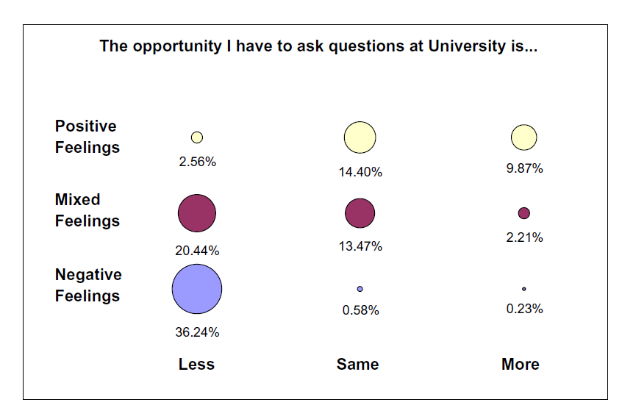
What else we know about ‘transitions’
Students at University reflected on changes regarding various aspects of teaching and learning:
Compared to pre-uni experience

Slide 20
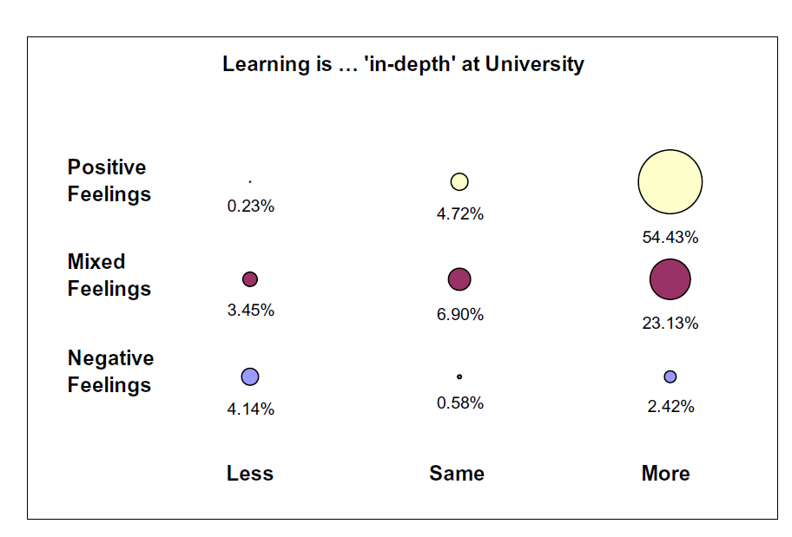

Slide 22
Two measures of ‘Transitional experience’
13 items of differences between pre-uni and uni experience
Dichotomously scored (change/no change)
Rasch Model
13 items of feelings
Negative, Mixed, Positive
Rating Scale Model
Perception of Transitional Gap
Positivity towards transition

Slide 23
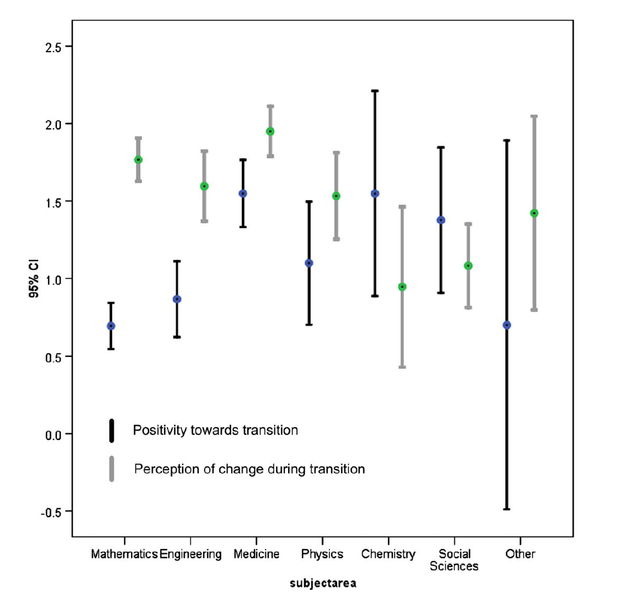
How is the transition experienced in different subject areas?
Notes:
Another interesting observation from the patterns in Figure 6 is the particularly
big gap in the scores of the two measures for mathematics and engineering: this
indicates that students in these courses perceived a big gap in their transition and
they seem to also be less positive about it compared to other groups. Medical students,
in contrast, even though they reported the highest levels of gap/change, are
also happier about this change.

Slide 24
Perceived ‘Support mechanisms’ with maths during transition

Slide 25
Perceived ‘Support’ by course type
STEM students agree higher % regarding the benefits of lectures, tutorials and working with fellow students compared to Non STEM students(i.e. 70% compared to 30% for lectures).

Slide 26
Measuring support during the transition
With these items we were also able to measure students’ perceived support in their maths learning during the first year at university

Slide 27
We also asked about students’ ‘perception of pedagogy’ pre-uni and uni

Slide 28
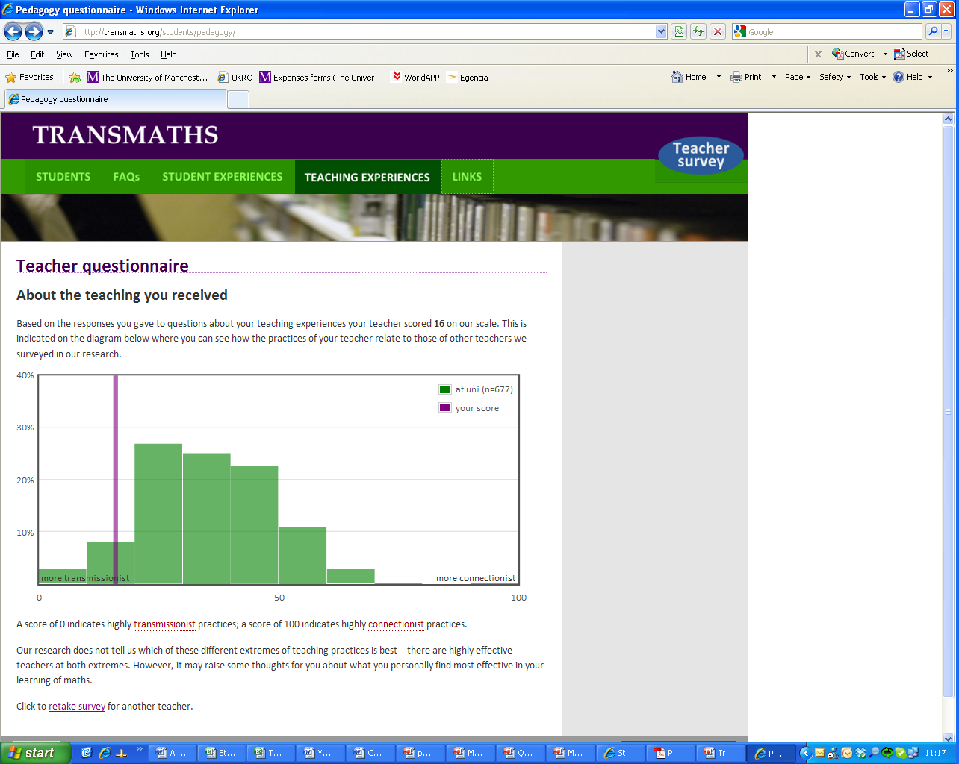
And constructed measures of ‘perceived transmissionist pedagogy

Slide 29
Bringing it all together….
(e.g. pedagogym dispositions, transitional experience etc)
Pearson Correlations UK results | Pedagogy at Uni | Pre-University Pedagogy
Math Support at University (DP5) | Non significant | -0.19 (p<0.05)
Transitional Feelings (DP5) | -0.20 (p<0.001) | Non significant
Disposition to Finish Course_DP5 | -0.12 (p<0.05) | Non significant
Math confidence (DP5) | Non significant | -0.17 (p<0.001)
MHE disposition (DP5) | Non significant | -0.19 (p<0.001)

